Slide 1
Data Models, MIMIC, and AKI
By Venkat Subramanian

Slide 2
Contents
Common Data Model, Vocabularies, and Cohorts
EHR Data and Common Data Model
Common Data Model Structure
Standardized Vocabularies
Concept Hierarchy
Cohort Definitions
Inclusion Criteria
MIMIC Data
MIMIC Background
DB Content Distributions
Phenotyping Acute Kidney Injury
AKI Overview
KDIGO AKI Definition
Phenotyping AKI
Results
Areas for Improvement
Reversible and Sustained AKI in MIMIC
Reversible and Sustained AKI Background
Reversible AKI for Baseline Criteria
SQL Results
Areas for Improvement
Reversible AKI for Creatinine Change
SQL Results
Areas for Improvement
Observations and Steps Forward

Slide 3
Common Data Model, Vocabularies, and Cohorts

Slide 4
EHR Data and Common Data Model
EHR data: overview of patient and health information in databases
Various goals and purposes of EHR data
Common data models for standardizing big health data and easier research
From: Observational Health Data Sciences and Informatics, Chapter 4 the Common Data Model | the Book of OHDSI, Ohdsi.github.io (Observational Health Data Sciences and Informatics, 2021), https://ohdsi.github.io/TheBookOfOhdsi/CommonDataModel.html.

Slide 5
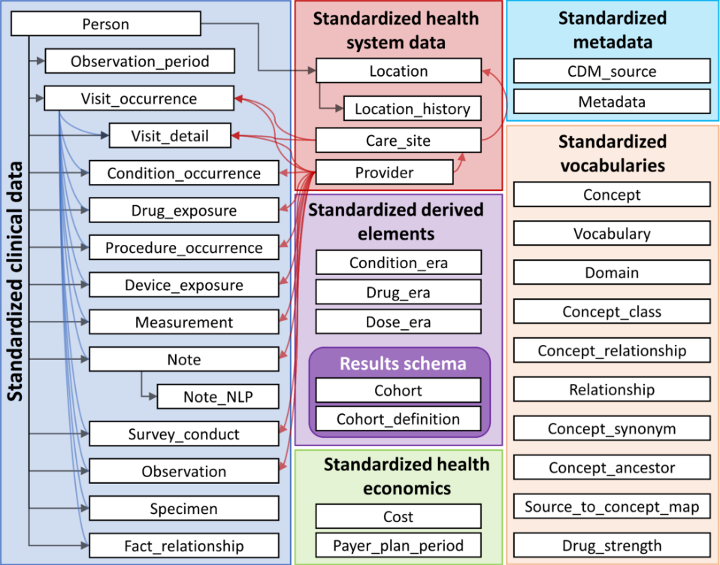
Figure 4.1 from Book of OHDSI

Slide 6
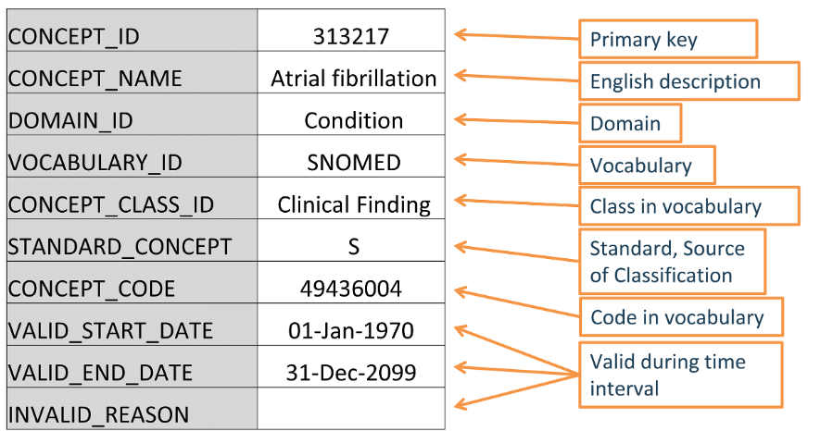
Standardized Vocabularies
Structure of an example entry in the CONCEPT table (Atrial fibrillation) – what standardized vocabulary is being used is identified (SNOMED)
Standardized vocabularies allow ease of research
Algorithms for databases in the common data model easily reusable
Utilizes concepts and domains
Figure 5.2 from Book of OHDSI

Slide 7
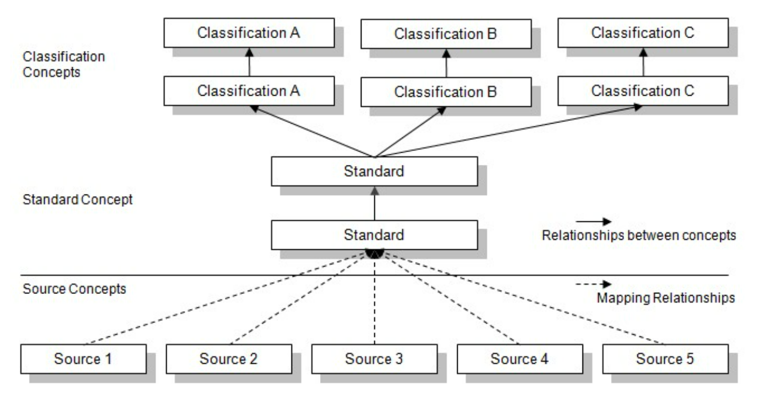
Figure 5.6 from Book of OHDSI

Slide 8
Cohort Definitions
Cohorts are a group that meet inclusion criteria over a time period
Inclusion criteria is logic that dictates whether patients are included in cohorts
Temporal logic: how codes, tests, and/or times interact with inclusion criteria for cohort inclusion
From: Observational Health Data Sciences and Informatics, Chapter 10 Defining Cohorts | the Book of OHDSI, Ohdsi.github.io (Observational Health Data Sciences and Informatics, 2021), https://ohdsi.github.io/TheBookOfOhdsi/Cohorts.html.

Slide 9


Slide 10
MIMIC Data

Slide 11
MIMIC Background
Medical Information Mart for Intensive Care
Active and developing dataset:
MIMIC III: 40,000 patients included in ICU admissions
MIMIC IV: Over 200,000 patients included in ICU admissions
2 databases from the Beth Israel Deaconess Medical Center (BIDMC)
Hospital-wide EHR data
ICU specialized clinical data
Includes hospital events from actual years from 2008 to 2019
Deidentification
Not in the common data model but shares many common features
382,278 total number of patients

Slide 12
105,670 Patients – Null or N/A
N = 276,608

Slide 13
N = 271,733
110,545 Patients – Null or N/A

Slide 14
N = 263,368

Slide 15
Phenotyping Acute Kidney Injury

Slide 16
AKI Overview
Also called “acute renal failure”
Rapid occurrence of kidney damage or failure
Timespan of hours or days
Various causes (and others):
Reduced blood flow
Hypotension, blood loss, burns, etc.
Direct kidney damage
Sepsis(infection), multiple myeloma(white blood cell cancer), etc.
AKI leads to (and others):
Buildup of waste in blood
Fluid imbalance
Chronic kidney disease
Heart disease
Information from: National Kidney Foundation, “Acute Kidney Injury (AKI),” National Kidney Foundation, 2017, https://www.kidney.org/atoz/content/AcuteKidneyInjury.

Slide 17
KDIGO AKI Definition
Kidney Disease Improving Global Outcomes (KDIGO) defines AKI as any:
Increase in serum creatinine (serum Cr, body waste product) >= 0.3 mg/dL within 48 hours
OR Increase in serum Cr above 1.5 times baseline serum Cr
Various “baseline serum Cr” definitions – all involve measurement of 7 days prior in some way
OR Urine output < 0.5 mL/kg/hr for 6 hours
Definition widely used in the literature (sometimes specifies only 1 or 2 out of the 3 criteria used in the study-specific cohort)
KDIGO AKI Definition from: “Q&A: KDIGO Criteria | ACDIS,” acdis.org, criteria#:~:text=As%20you%20have%20said%2C%20KDIGO.

Slide 18
Phenotyping AKI
Serum creatinine criteria (1.5 times baseline and 0.3 mg/dL increase) used instead of urine output criteria
Some studies say the KDIGO urine output definition is too liberal
AKI can be oliguric or non-oliguric
Allows consistency with serum creatinine definitions for definitions of AKI recovery later
Urine output in EHR is unreliable or often incomplete

Slide 19
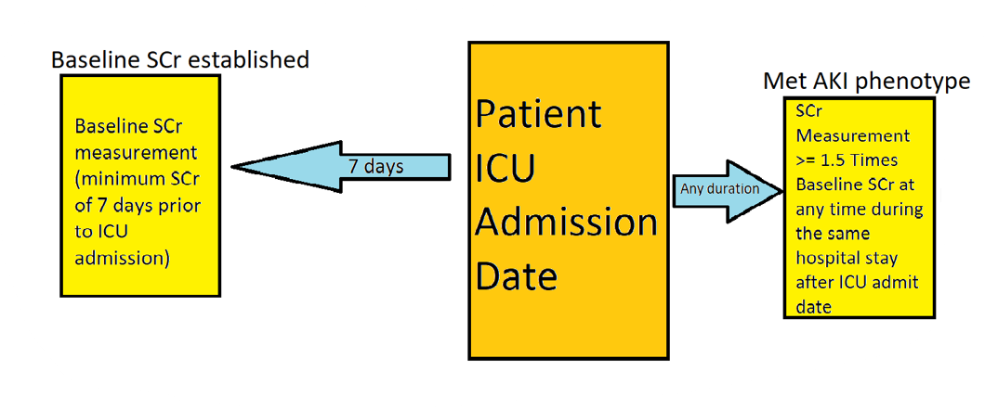
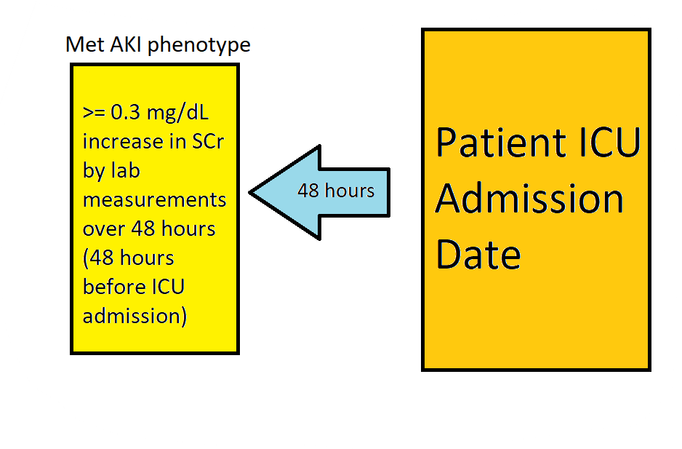
Selection criteria (implemented in SQL Server)
>= 1.5 times baseline SCr criteria:
Baseline serum creatinine defined as the minimum serum creatinine level recorded within the 7 days prior to ICU admission (exclude if no 7-day-prior baseline available)
SQL logic: Add in all SCr lab measurements for a patient 7 days before the ICU stay (identify baseline and any instance within entire ICU stay of SCr going over 1.5 times baseline)
SCr increase by >= 0.3 mg/dL 48 hours before ICU admission
SQL logic: Add in all SCr lab measurements for a patient 48 hours before ICU stay (identify minimum and maximum and if difference is >= 0.3 mg/dL)
Baseline definition: Guang-ju Zhao et al., “Association between Furosemide Administration and Outcomes in Critically Ill Patients with Acute Kidney Injury,” Critical Care 24, no. 1 (March 4, 2020), https://doi.org/10.1186/s13054-020-2798-6.

Slide 20
Results from 1.5 Times Baseline SCr Criteria
17.98% all SCr measurements in MIMIC meet KDIGO AKI-criteria
20.41% all MIMIC IV ICU stays meet this KDIGO AKI-criteria
15,621 ICU stays with KDIGO AKI-criteria meeting SCr lab measurements

Slide 21
Results from 0.3 mg/dL Increase SCr Criteria
6,372 unique ICU stays with KDIGO AKI-criteria meeting SCr lab measurements
8.3% of all MIMIC IV ICU stays meet this KDIGO AKI-criteria

Slide 22
Integrating Criteria
Patients in AKI cohort in both, then included
Patients included in AKI cohort in only one criteria, then included
All other patients not included
Integrating criteria not implemented, but can be in the future
Pooled rates estimates match other studies (AKI incidence in ICU)

Slide 23
Areas for Improvement
48 Hour 0.3 mg/dL criteria only handles 48 hours before ICU admission, not all 48 hour intervals
Excludes patients without baseline SCr measurements
Excludes patients without SCr measurements during timeframes
2 criteria could have overlapping patients/AKI instances (integrating criteria solves)

Slide 24
Reversible and Sustained AKI in MIMIC

Slide 25
Reversible and Sustained AKI Background
Reversible/Reversed/Transient Acute Kidney Injury:
No actual kidney tissue injury
Decreased kidney filtration
Caused by decreased perfusion
Resolves with better perfusion
Takes hours or days to resolve
Sustained Acute Kidney Injury:
Actual internal kidney tissue damage
Intrinsic kidney tubules problems with filtration
Can take weeks to resolve
Both have different treatments and prognosis

Slide 26
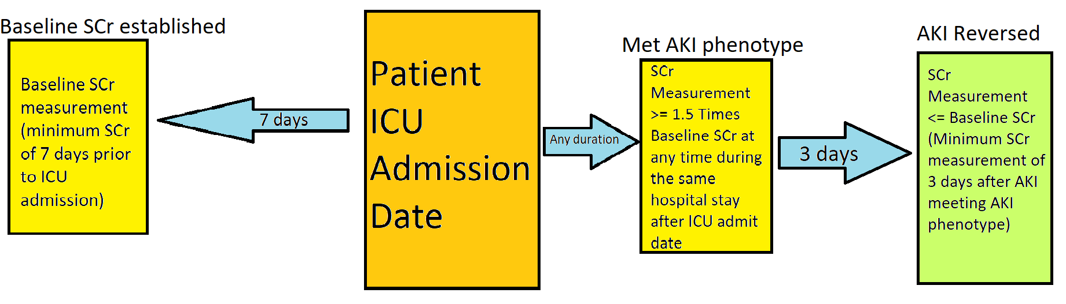
Reversible AKI for Baseline Creatinine Criteria
After meeting AKI phenotype with SCr over 1.5 times baseline in last 7 days
If SCr returns to <= baseline within next 3 days, AKI resolved/reversed/was transient
1.5 Times Baseline Creatinine Criteria Time Frame
Criteria definition from: John A. Kellum, “Persistent Acute Kidney Injury,” Critical Care Medicine 43, no. 8 (August 2015): 1785–86, https://doi.org/10.1097/ccm.0000000000001102.
Notes:
https://www.ncbi.nlm.nih.gov/pmc/articles/PMC4507291/

Slide 27
Reversible AKI for Baseline Creatinine: SQL Results
42.96% of patients phenotyped with AKI by the 1.5 times baseline creatinine criteria in an ICU stay had transient AKI
6,711 unique ICU stays where AKI reversed
**Underestimates AKI reversal rates

Slide 28
Reversible AKI for Baseline Creatinine Areas for Improvement
Does not consider diuretic use as of now
Patients with multiple reversed AKI criteria SCr measurements included all measurements

Slide 29
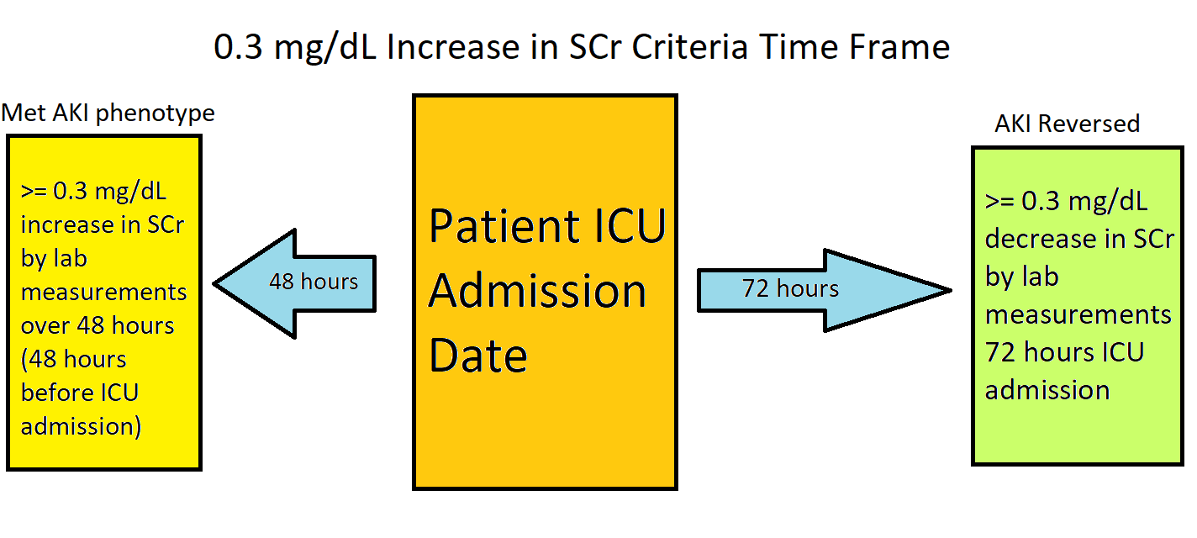
Reversible AKI for Creatinine Change (>= 0.3 mg/dL Increase in 48 hrs)
After meeting AKI phenotype with >= 0.3 mg/dL increase in SCr within 48 hours
If SCr goes down by >= 0.3 mg/dL below previous max within 72 hours, AKI reversed
Criteria definition from: Ravindra L. Mehta, “Renal Recovery after Acute Kidney Injury and Long-Term Outcomes,” JAMA Network Open 3, no. 4 (April 13, 2020): e202676, https://doi.org/10.1001/jamanetworkopen.2020.2676.
Notes:
https://jamanetwork.com/journals/jamanetworkopen/fullarticle/2764344#:~:text=Of%20the%20patients%20with%20AKI,to%20baseline%20creatinine%20concentration%20at

Slide 30
Reversible AKI for >= 0.3 mg/dL Increase in 48 hrs: SQL Results
4,476 ICU stays with transient AKI by this criteria
**Overestimates AKI reversal rates
70.24% of patients phenotyped with AKI by the 0.3 mg/dL increase in creatinine criteria in an ICU stay had transient AKI

Slide 31
Reversible AKI for >= 0.3 mg/dL Increase in 48 hrs Areas for Improvement
Does not consider diuretic use as of now
Patients with multiple reversed AKI criteria SCr measurements included all measurements
Only considers values 48 hours before ICU admission and 72 hours after
Ignores patients without SCr measurements 72 hours after ICU admission
Distance between AKI phenotype-meeting SCr measurement and reversal could be larger than 72 hours (Range possible: [72 hours, 120 hours])

Slide 32
Sustained AKI
Patients without transient AKI by either the 1.5 times baseline SCr or 0.3 mg/dL SCr increase criteria are considered to have “sustained AKI”

Slide 33
Observations and Steps Forward
Massive difference in reversed instances explained by timeframe (baseline creatinine AKI reversed algorithm more inclusive)
Can merge with urine output definitions in phenotyping to get stronger AKI patient group
More info recorded:
Can use changes in SCr levels to define AKI stages
Can define more scenarios where SCr is not recorded over certain timeframes

Slide 34
Thank you!
Questions?

